Slide 1
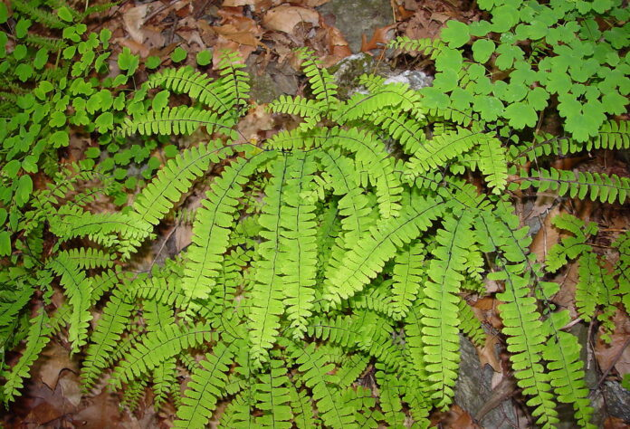
Adiantum: Reproduction
Dr. Jahid Ali Malik

Slide 2
Reproduction
Vegetative propagation is brought about by buds produced at the leaf tips. The buds enter the ground when the leaf bends and touches the soil. There they develop into a new individual. This, in turn may repeat the process leading to the walking Habit. Walking habit is seen in A. caudatum.

Slide 3
Reproduction by Spores
Spores are produced in the sporangia.
All the species are homosporous
The sporangia are borne in groups , called sori.
Sori are borne at the distal end of pinnae.
The margin of pinnule blade is folded towards the lower side to form false indusium

Slide 4
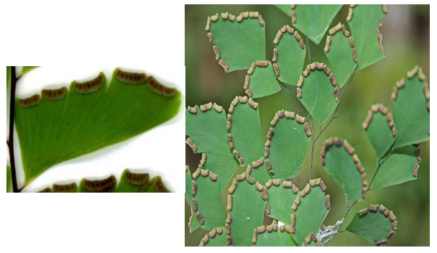
Reproduction by Spores

Slide 5
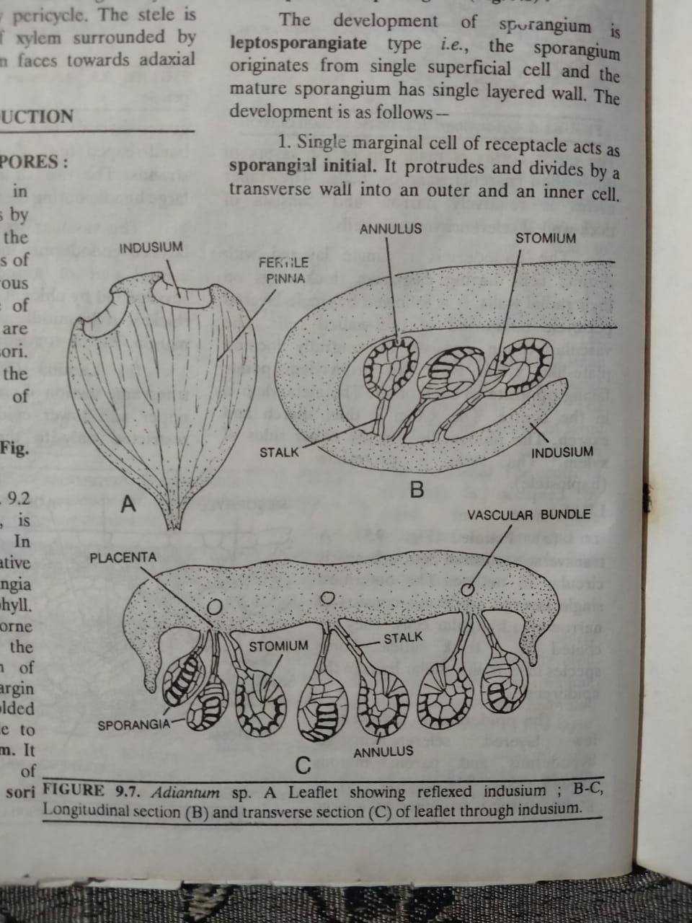
Reproduction by Spores

Slide 6
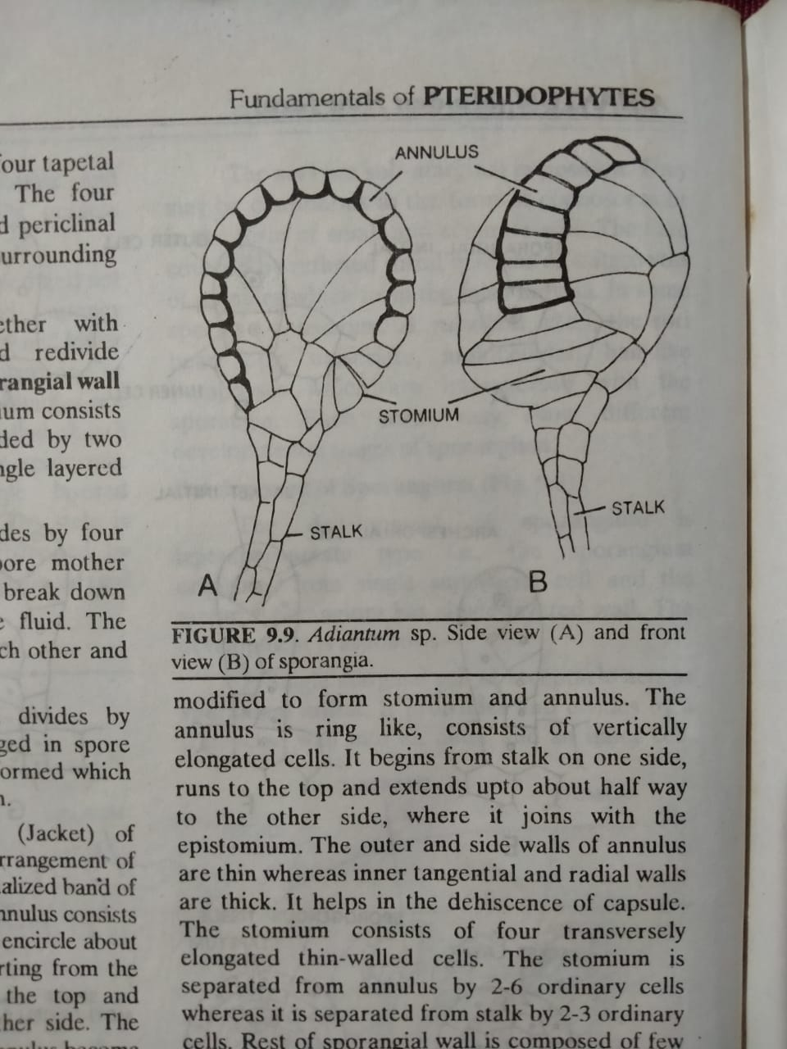
Structure of the Sporangium
It consists of a stalk and upper swollen portion called capsule.
.
Stalk is made up of three rows of cells.
Capsule is covered with single layered wall.
Wall consists of two portions Annulus and Stomium

Slide 7
Structure of the Sporangium
Annulus portion contains cells with thick radial and inner tangential cell walls. Stomium consists of cell with thin cell walls. This is the site for bursting of sporangia. Inside sporangia, spores are produce by meiosis of spore mother cells. Many spores are produce inside sporangia. Spore wall contains two layers exine and intine.

Slide 8
Dehiscence of the sporangium
When spores get mature, the wall of sporangia burst. Sporangium becomes dry, so the cells of annulus region contracts which exerts pressure on stomium cells. Stomium is weak region of wall of sporangia, so sporangia get burst from this region. Bursting of sporangia caused the dispersal of spores. After falling on suitable place, spore germinates. During germination, exine of spore bursts and intine elongate into a tube like structure. The apical portion of tube gives rise to new generation of Adiantum the gametophyte generation.

Slide 9
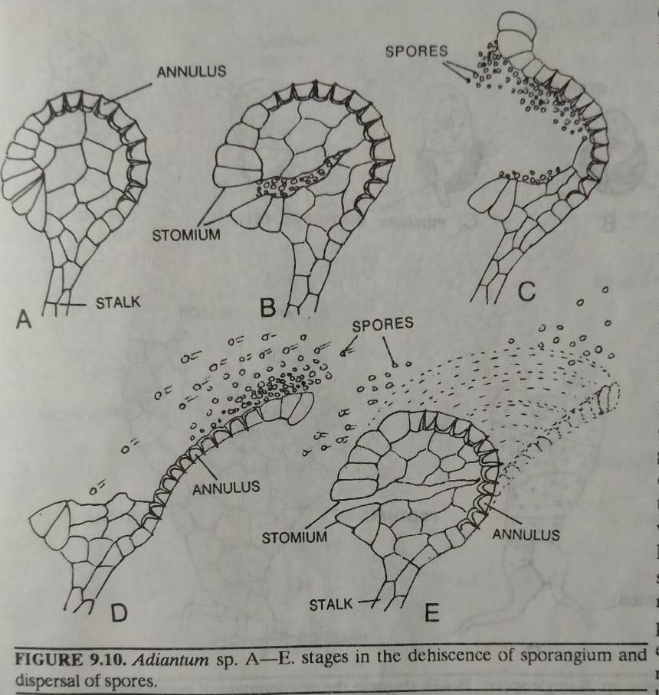
Dehiscence of the sporangium

Slide 10
Gametophyte of Adiantum:
Gametophyte of Adiantum has heart like shape. It has a notch, where growing point reside. Gametophyte of Adiantum is many cells thick from center and only one cell thick at margins. Rhizoids are produce from underside of Gametophyte for anchorage and absorption of water and nutrients. Gametophyte contains chloroplast, so carried out photosynthesis. Gametophyte is independent. Two kinds of organs antheridia and archegonia are produce on gametophyt

Slide 11
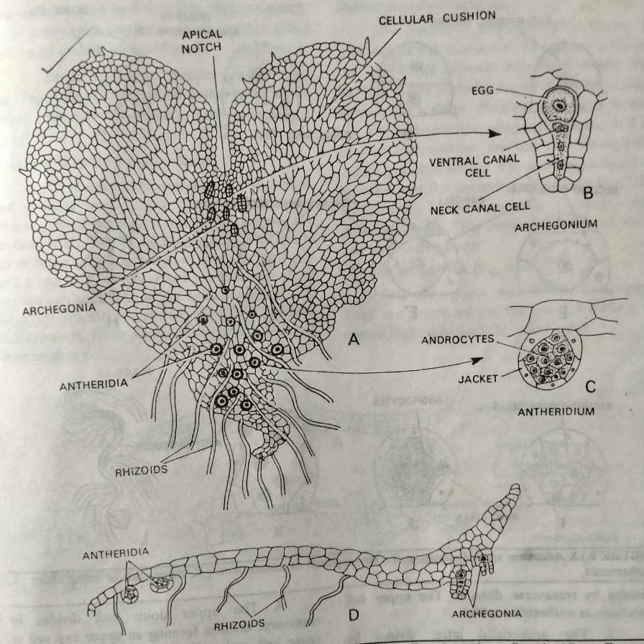
Gametophyte of Adiantum:

Slide 12
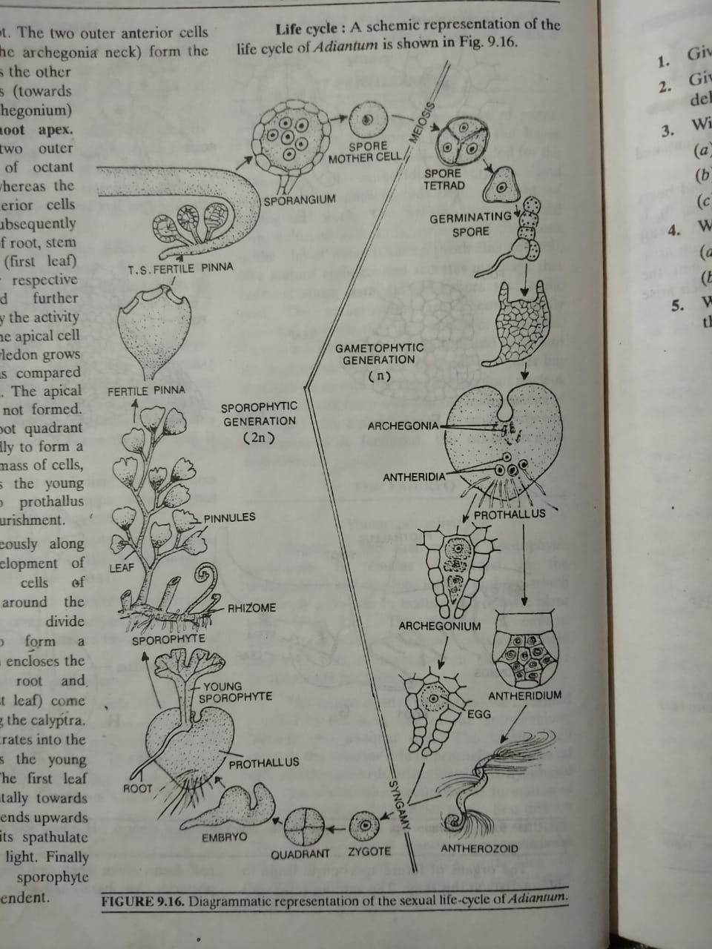
Life cycle of Adiantum:

Slide 13


